Slide 1


Bennettswood Scout Group
Information and Leader resources

Slide 2
Design and deploy an app for the 1st Bennettswood Scout Group
Public information pages showcasing the group and section information
Ability for leaders and Members to login to a private forum
Ability to have administration privileges over users –
Authorise / deauthorise a user
Edit and delete users
Edit and delete forum posts and comments
Forum pages to have links and images
To be able to only show forum pages from sections

Slide 3
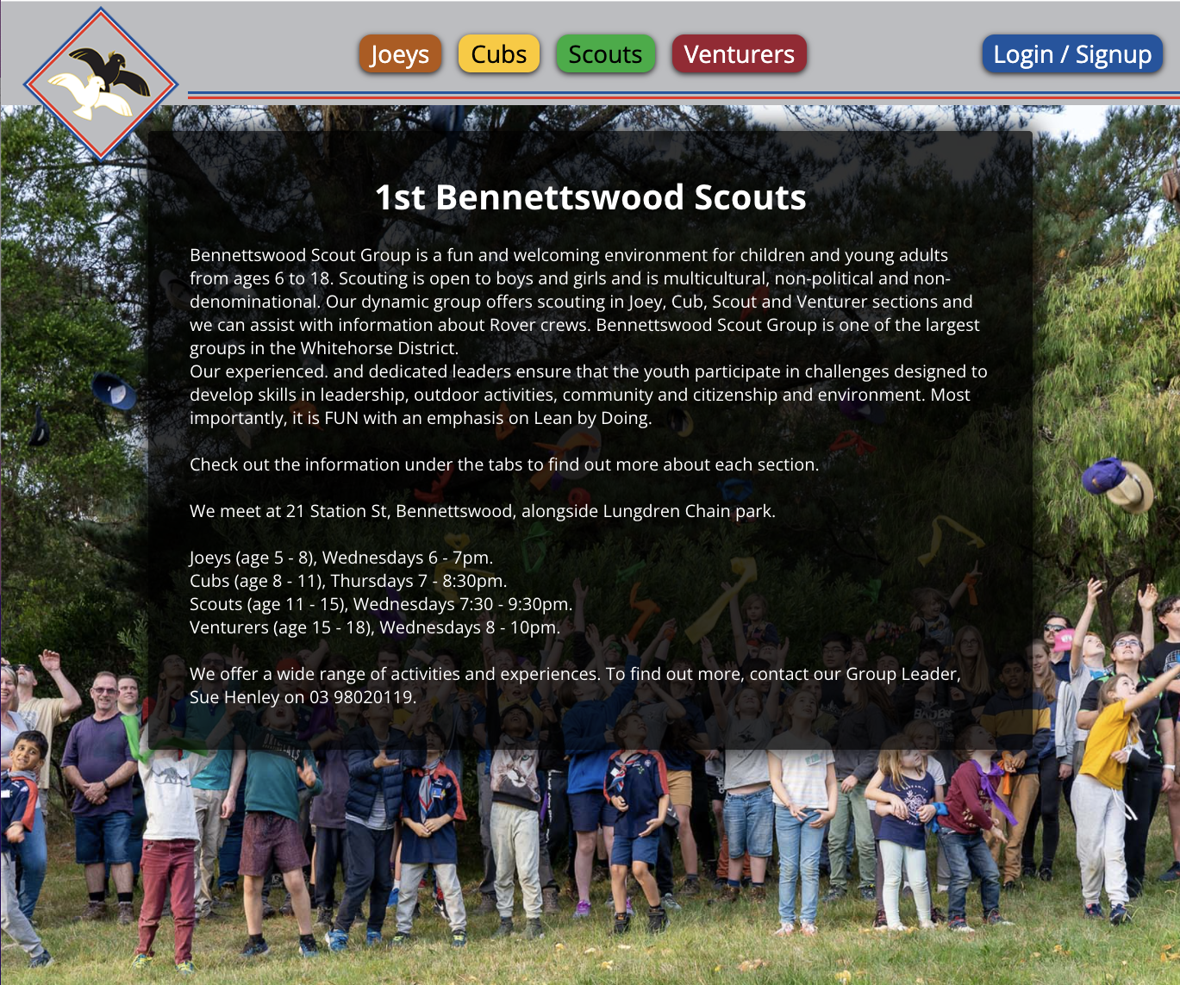

Slide 4
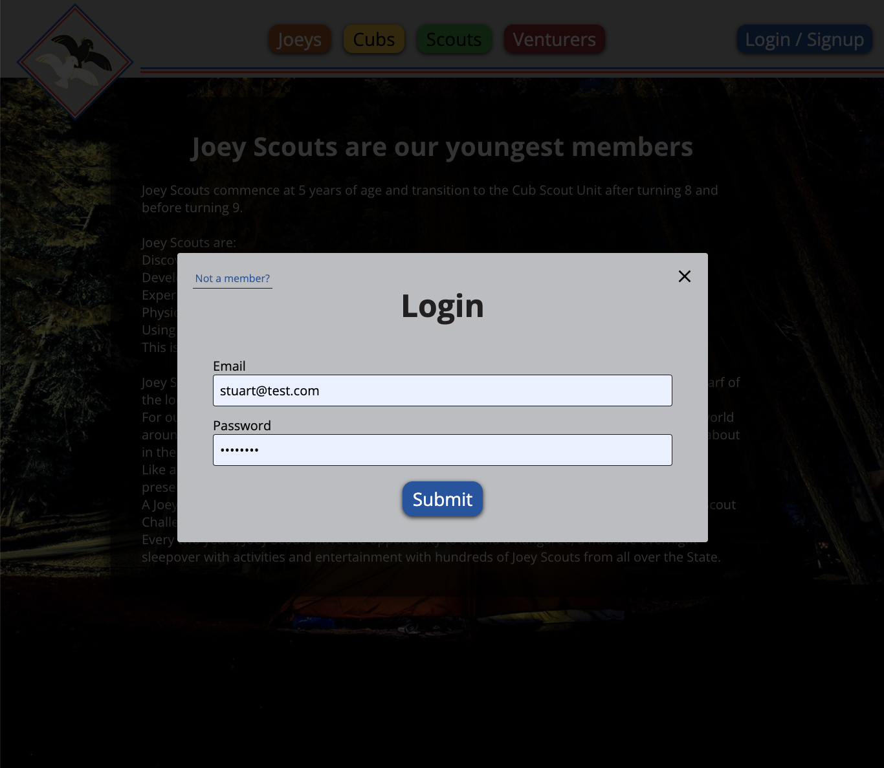
User Login and Signup

Slide 5
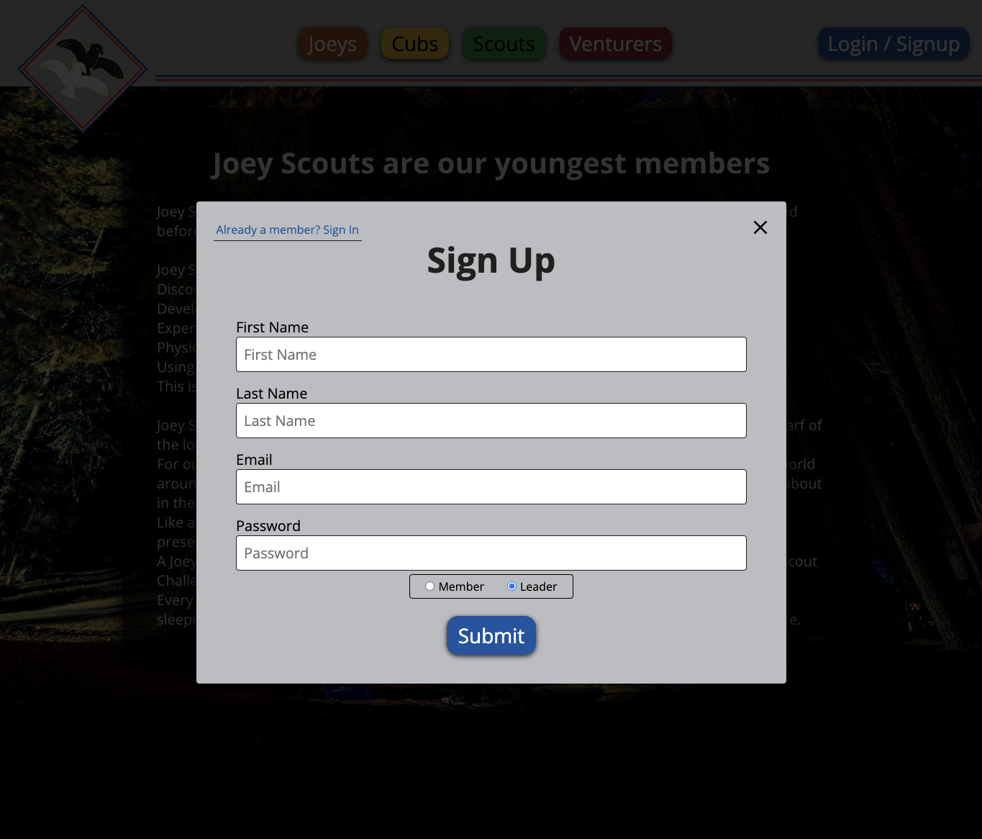
User Login and Signup

Slide 6
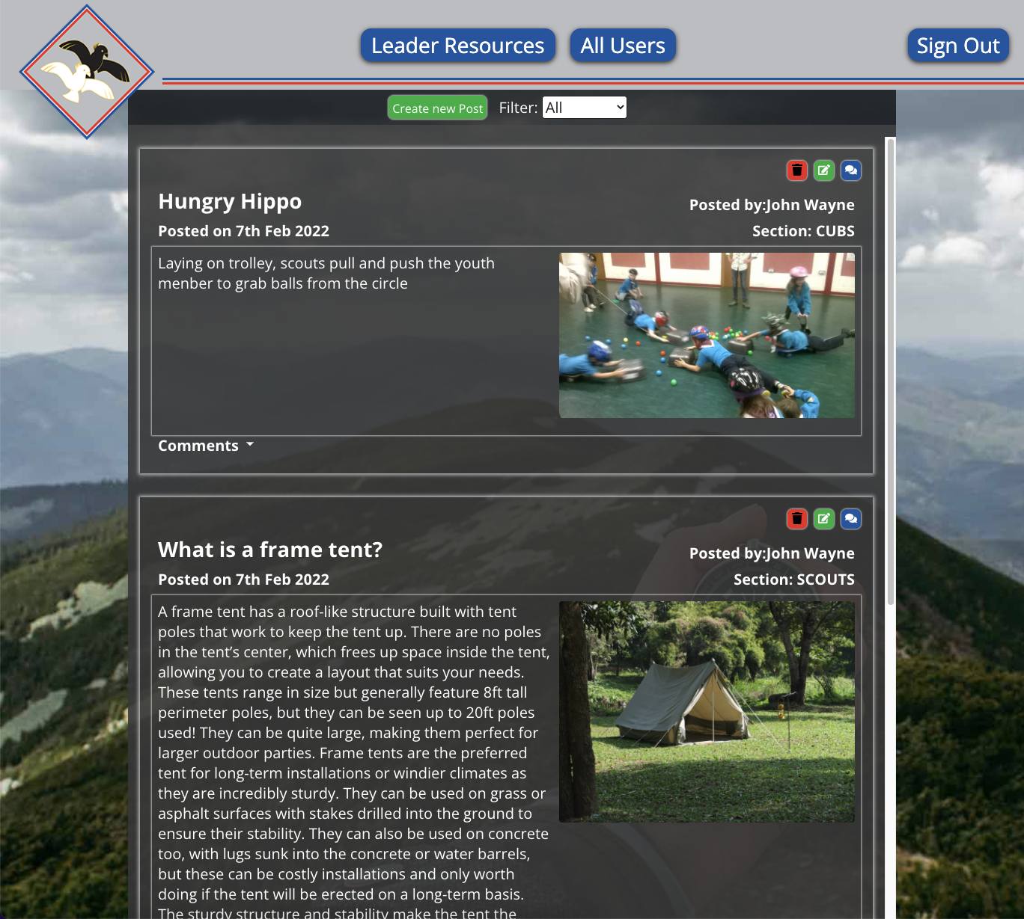
Forum

Slide 7
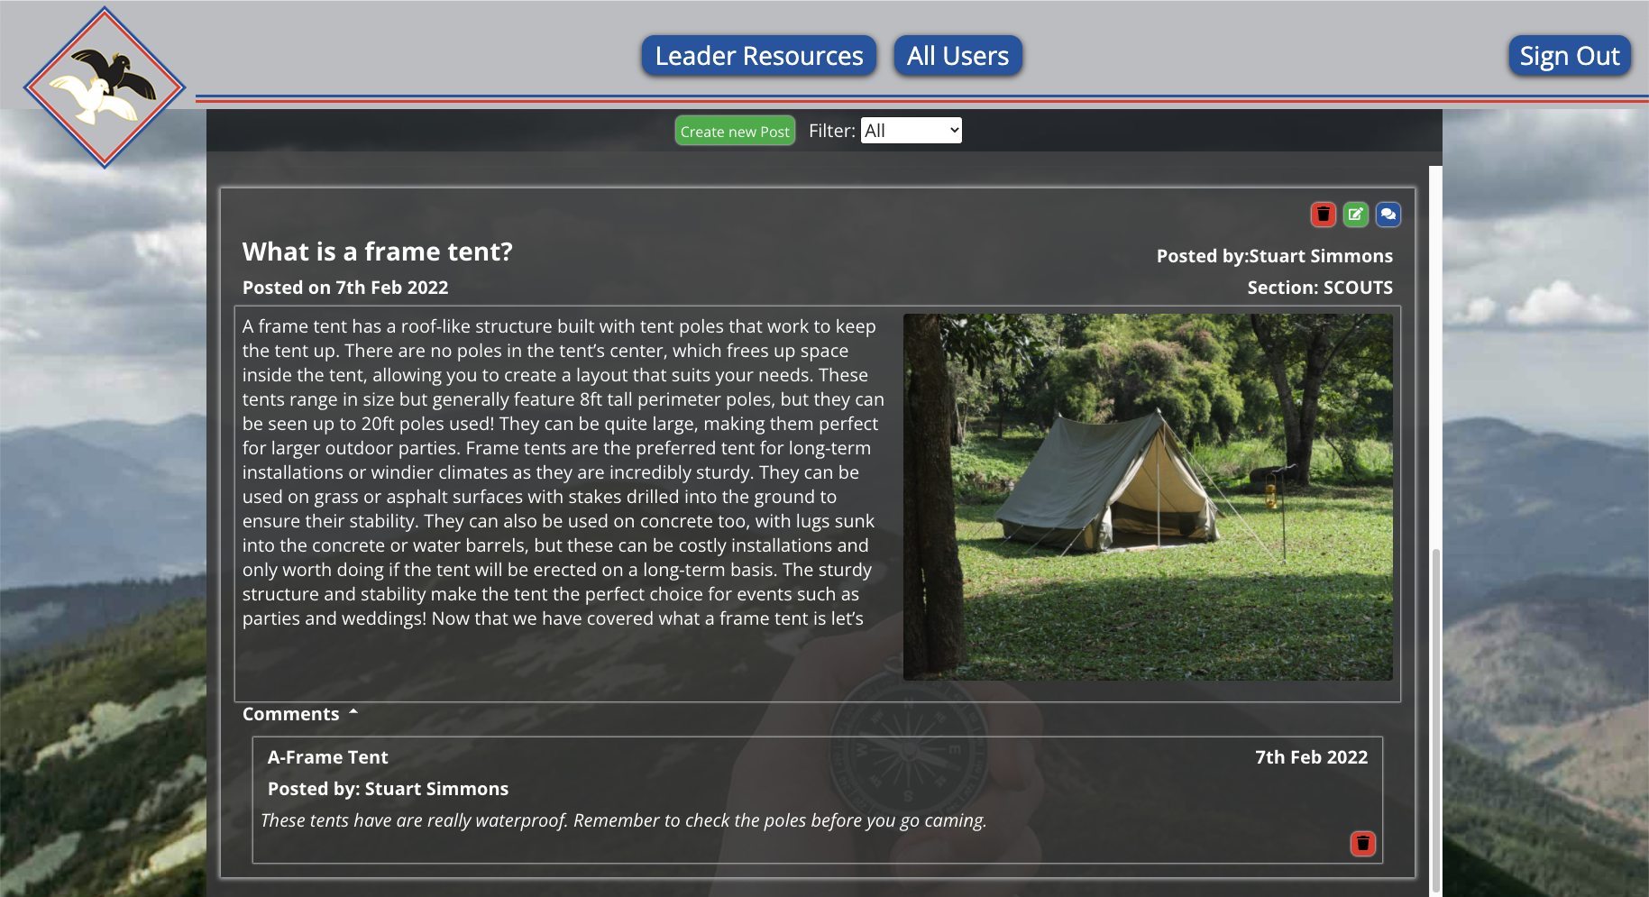
Viewing Comments

Slide 8
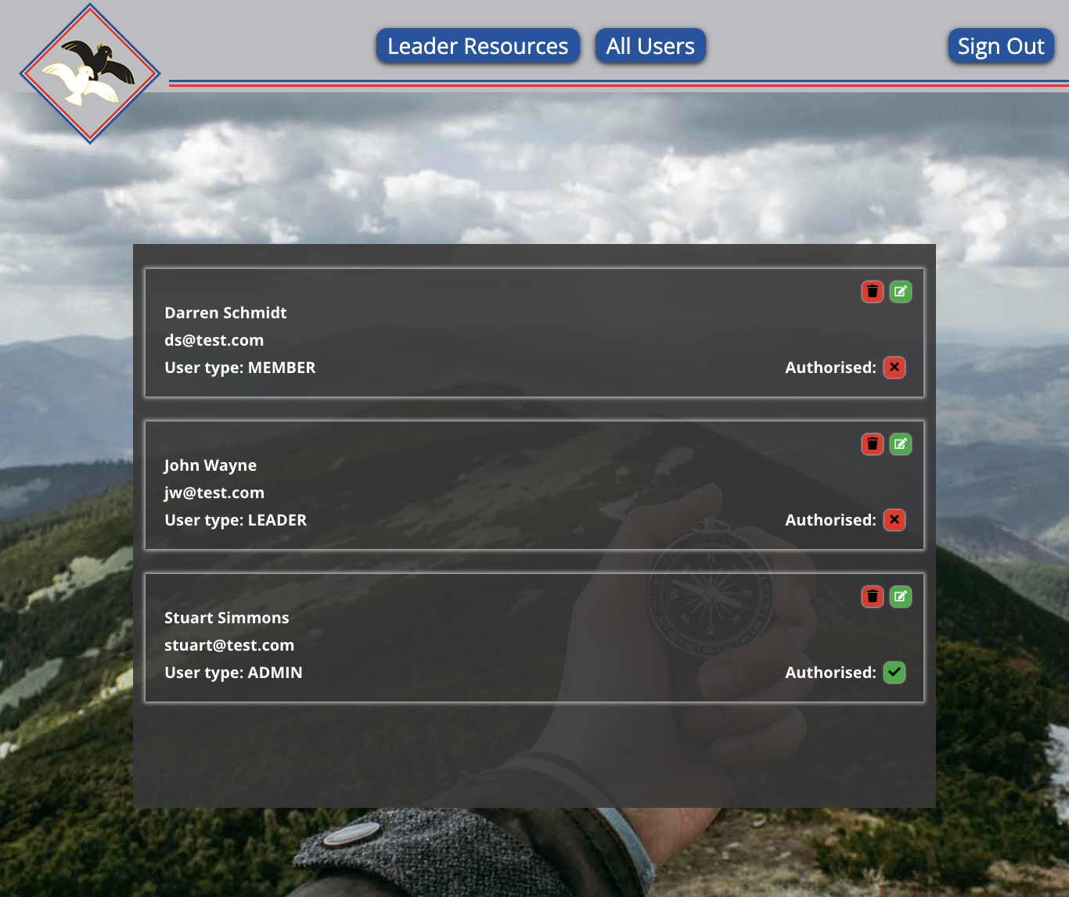
All Users – Admin view

Slide 9
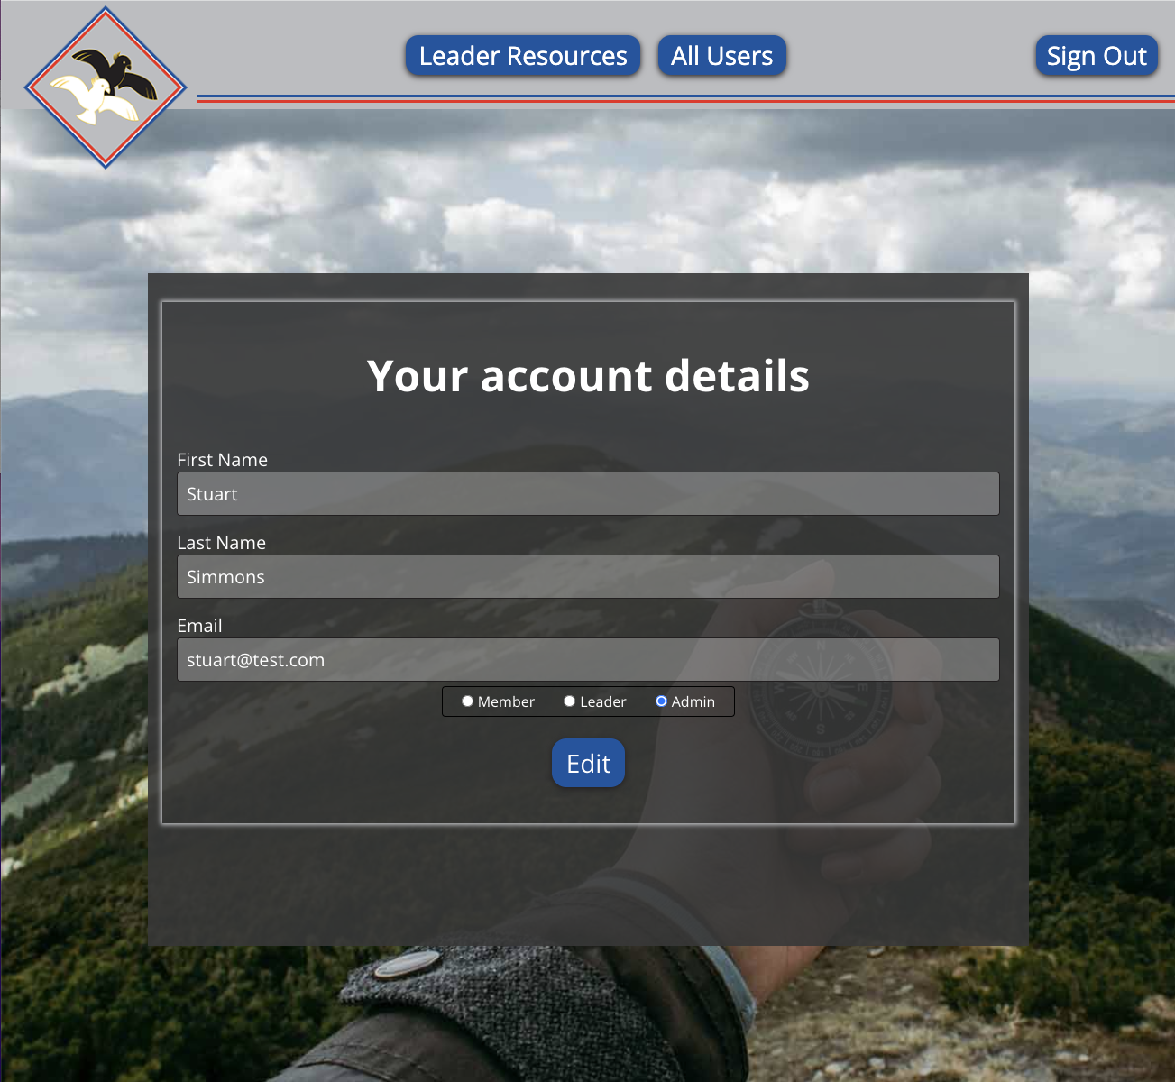
All Users – Admin view

Slide 10
Technical Requirements
Use React to develop the app
Use SQL as the database backend
Use Apollo Server / Client and graphql as middleware
Use Sequelize as the ORM
User authentication and password hashing
Some Additional Libraries used
Styles Components
Date-FNS
React Icons
React Toastify – Page alerts and notifications

Slide 11
Challenges
Using MySQL and getting the Apollo server interface to communicate.
Learning how to hide and show modals with React.
Hide and show comments for forum posts.
Having an admin user along with regular users.
Learning styled components and passing props to the css.

Slide 12
Live demo on Heroku
1st Bennettswood Scout Group

Slide 13
Future Development
Add additional information pages
Truncate text in the forum using ellipsis
Add search function
Adding a q-store database
Track equipment
Value
Booking system
Flag repairs / maintenance

Slide 14
Thank You

